Slide 1
Unit 6

Slide 2
Outline
Reading Summary
Definition
Formulas
Additional Resources

Slide 3
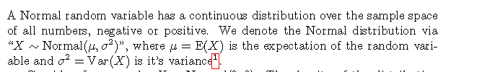
Summary
The Normal distribution is the most important of all distributions that are used in statistics.
even in cases where the measurement is modeled by other distributions (i.e. Binomial, Poisson, Uniform, Exponential, etc.) the Normal distribution emerges as an approximation of the distribution of numerical characteristics of the data produced by such measurements.
The density of the Normal distribution can be computed with the aid of the function “dnorm". The cumulative probability can be computed with the function “pnorm".

Slide 4
Summary
The standard normal distribution is a normal distribution of standardized values, which are called z-scores.
A z-score is the original measurement measured in units of the standard deviation from the expectation.
The expectation for the standard Normal distribution is 0 and the variance is 1.
The Normal distribution emerges frequently as an approximation of the distribution of data characteristics.
The probability theory that mathematically establishes such approximation is called the Central Limit Theorem

Slide 5
Summary
The important point is that the Normal distribution may serve as an approximation to a wide class of distributions
It is important not assume that any distribution is well approximated by the Normal distribution.

Slide 6
Summary
When n is large and p is small then the Poisson distribution may produce a better approximation of a Binomial probability. When the Poisson distribution is used for the approximation we call it a Poisson Approximation.
When n is large and p is large, use the Normal approximation to approximate the binomial distribution. When n is small and p is large, use the Normal approximation with correction ([x-0.5; x + 0.5]) to approximate the binomial distribution.

Slide 7
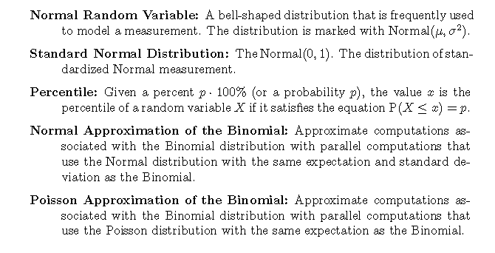
Definition

Slide 8
Additional Resources
https://www.youtube.com/watch?v=iYiOVISWXS4 (Normal Distribution)
https://www.youtube.com/watch?v=4R8xm19DmPM (Standardizing Normal Distribution)
https://www.youtube.com/watch?v=Pujol1yC1_A (Central Limit Theorem)
https://newonlinecourses.science.psu.edu/stat414/node/91/ (Normal Distribution)
https://www.youtube.com/watch?v=mJjtvsPPtEA (Calculating Normal Probabilities in R)

Slide 9
Additional Resources
https://www.youtube.com/watch?v=c11d3vVM5v8 (What is a "Standard Normal Distribution"?)
https://www.youtube.com/watch?v=gI5y3RZe9fk (The Normal Probability Distribution)
https://www.youtube.com/watch?v=g7FVtTvFUgM (Area Under the Normal Probability Distribution)
https://www.youtube.com/watch?v=A60szMsurcA (Using the pnorm function for normal distribution)

Slide 10
Additional Resources
https://www.youtube.com/watch?v=k9nRcadQYsU (The Normal Approximation of the Binomial Distribution)
https://www.youtube.com/watch?v=CCqWkJ_pqNU (The Normal Approximation of the Binomial Distribution)

